Slide 1
By Mrs. Baggett

Slide 2
Objectives:
Students will write a descriptive paragraph describing their mystery Lovebug.
Students will use strong adjectives when writing their paragraph.
Student will use Ctrl C and Ctrl V to copy and paste their Love Bug.

Slide 3
Directions
Go to slide 5. Look over the Love Bugs and choose one.
Go to slide 4. You will now be writing a descriptive paragraph about your Love Bug. Make sure to add a lot of detail so your partner can choose the correct bug!
Afterwards, you will trade your writings with a partner and guess which mystery Love Bug they are describing.

Slide 4
Paste Your Love Bug Guess Here!
Type here
Make sure to describe your Love Bug using details and strong adjectives.

Slide 5
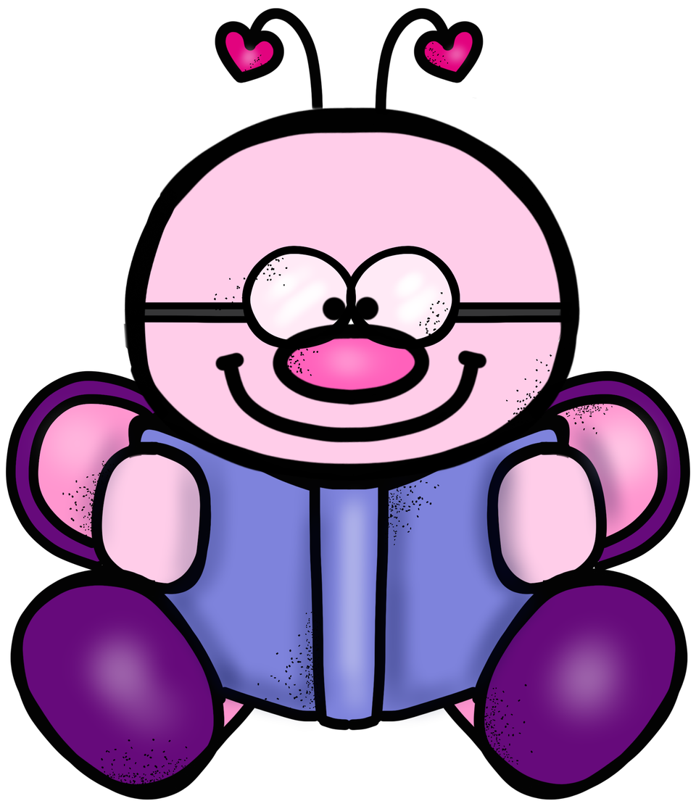
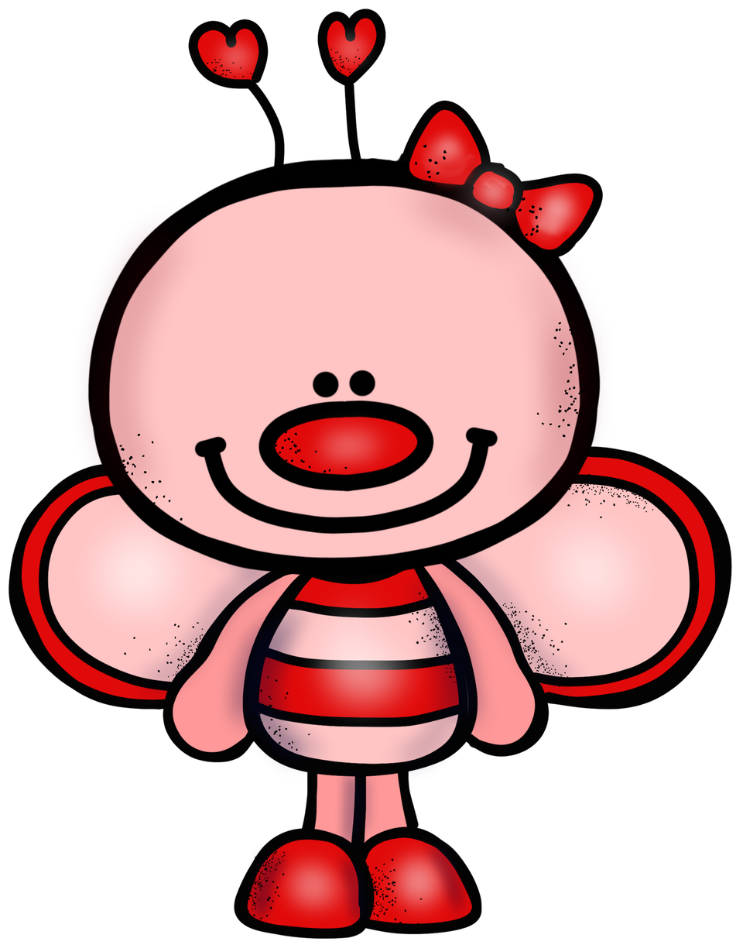
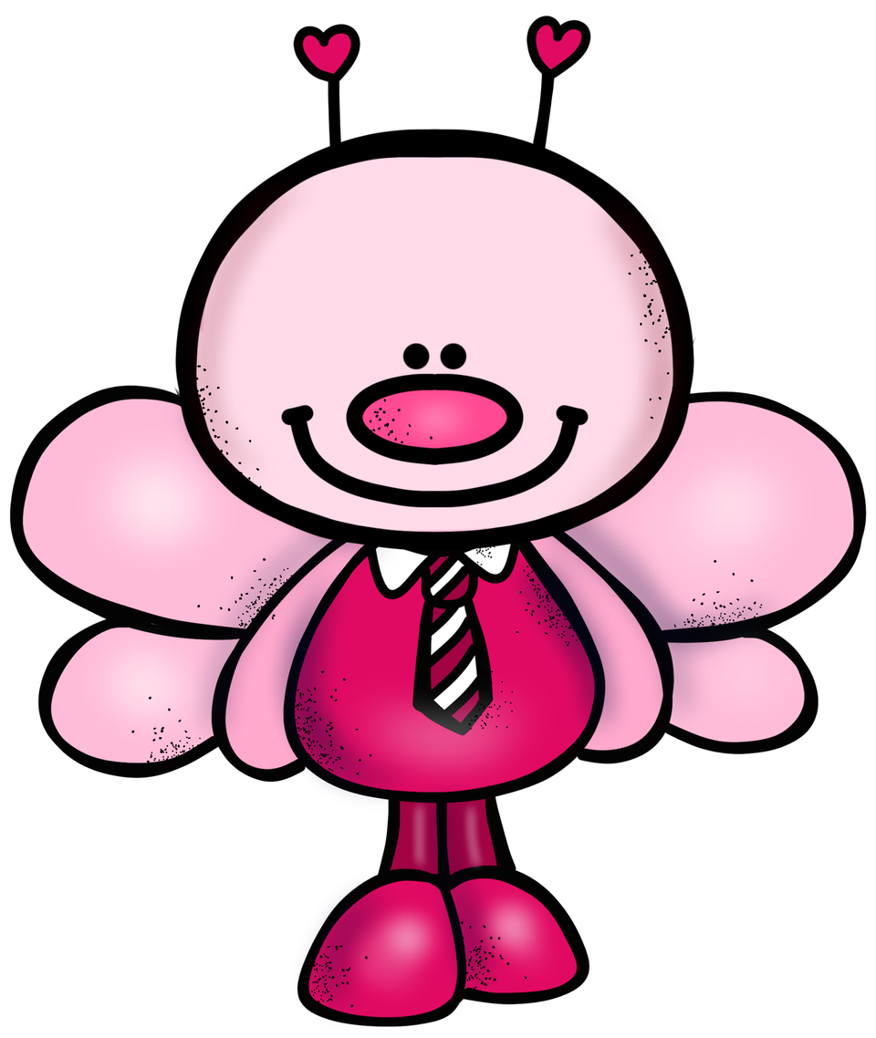
Choose one of the Lovebugs above.

